Slide 1


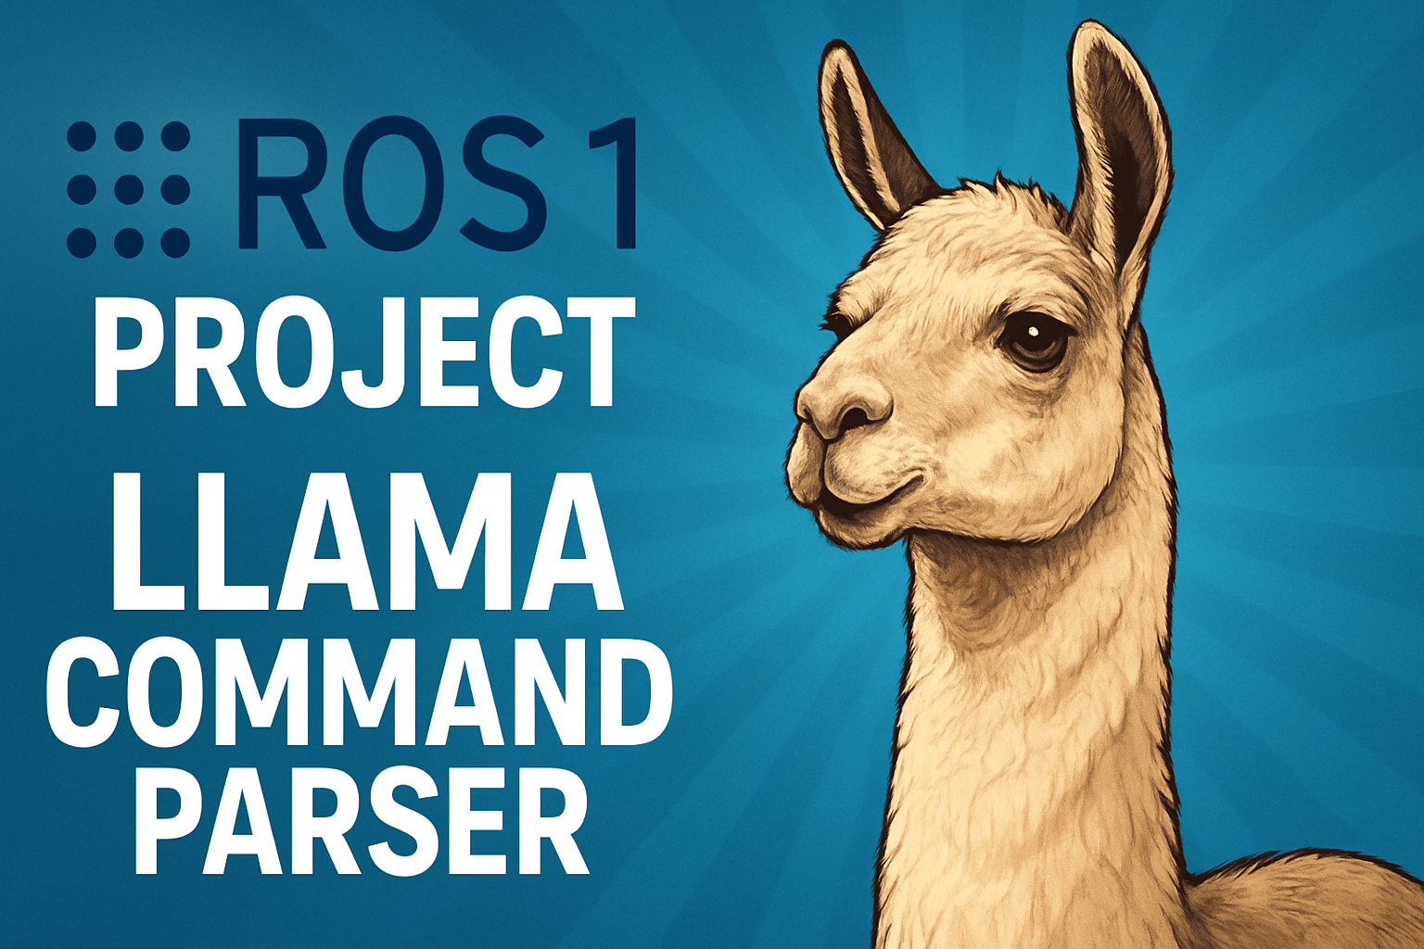
ROS-LLaMA
Politehnica University of Bucharest
- ROS 1 with Llama 3.2 -
Author:
Farhad Ali Irinel Gul

Slide 2
Architecture
publisher.py
/llama_parser
/input
ros-llama.py
/llama_parser
/commands
subscriber.py
Node
Topic
Pick the glass and place it on the kitchen table.
LOCAL PROCESSING
["pick", "glass", "place", "kitchen_table"]

Slide 3
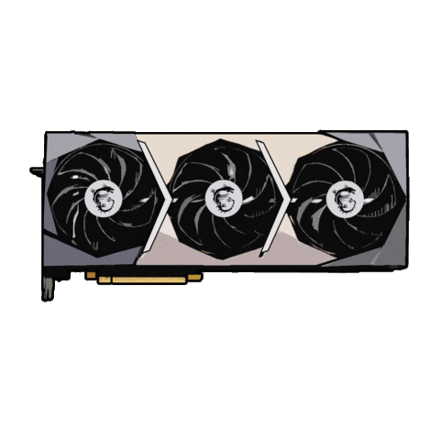
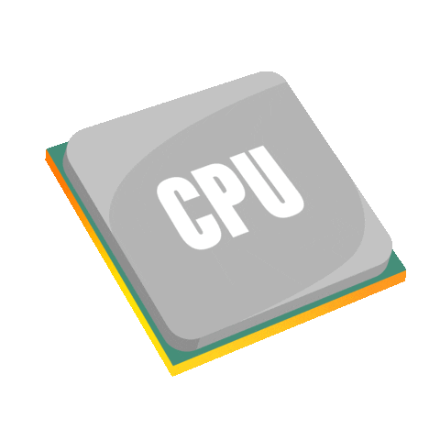


Station
Hardware
BLAS, OpenMP support
RAM – 16 GB
Software
Ubuntu 24.04
CPU – AMD Ryzen 7 5800H with 8 cores, 16 threads
NVIDIA RTX 3050 Laptop – 4GB VRAM
Docker with Ubuntu 20.04 (ros:noetic)

Slide 4
Scripts
Dockerfile
Contains docker image with ROS1
start.sh
Docker build
Compiles ROS
Copy the .py scripts
Start master node
terminals.sh
Starts LLM node,
Starts publisher node,
Starts subscriber node

Slide 5
Llama 3.2
Format
GGUF
Quantization
4 bits per weight (Q4)
File size
1.9 GB (Q4)
Parameters
3 bilions
Instruction Tuned
chat
summarizaton
28 layers
8 bits per weight (Q8)
3.2 GB (Q8)

Slide 6
Gemma 3
Format
GGUF
Quantization
2 bits per weight (Q2)
File size
4.1 GB (Q2)
Parameters
12 bilions
Instruction Tuned
chat
summarizaton
49 layers
4 bits per weight (Q4)
6.8 GB (Q4)

Slide 7
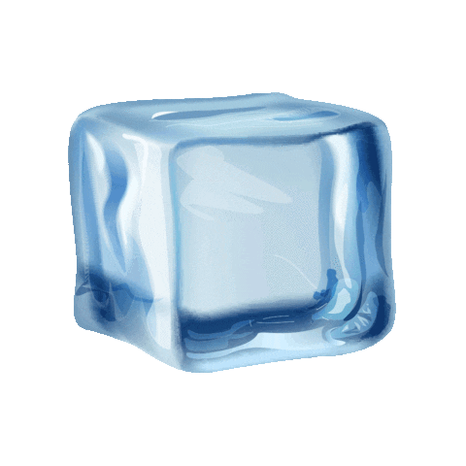

79.1 s
33.1 s
1.4 s
10.3 s
2.5 s
8.1 s
9.8 s
7.2 s

Slide 8
10
10
8
8
6
5
5

Slide 9
Conclusions
Portable
Offline AI access
Easy to change models
Multi-threaded support on CPU
GPU-compatible
Scalable
Easy to use

Slide 10
Bibliografie
https://www.ros.org/ [Accessed on March 3, 2025]
https://huggingface.co/bartowski/google_gemma-3-12b-it-GGUF [Accessed on March 10, 2025]
https://huggingface.co/unsloth/gemma-3-12b-it-GGUF [Accessed on March 10, 2025]
https://huggingface.co/bartowski/Llama-3.2-3B-Instruct-GGUF [Accessed on March 10, 2025]
https://huggingface.co/unsloth/Llama-3.2-3B-Instruct-GGUF [Accessed on March 10, 2025]
https://hub.docker.com/_/ros/ [Accessed on May 3, 2025]
https://pypi.org/project/llama-cpp-python/0.1.9/ [Accessed on May 23, 2025]
https://github.com/FarhadGUL06/ros-llama.git [Accessed on June 14, 2025]

